Slide 1
Module 1
Requirements and Responsibilities

Slide 2
Chief 101 Class
This class consists of several programs that together will satisfy the 9S inspection criteria as specified by the North Carolina Administrative Code. The primary objective of the course is to inform current and future chief officers of the various aspects and complexities surrounding the operations and organization of North Carolina fire departments.

Slide 3
Requirements and Responsibilities
Why are we Here?
Chief 101 started as a result of the 2009 Gateway Conference held in Raleigh NC.
Requirements for the Chief 101 course were placed within the North Carolina Administrative Code as written for Fire Department 9S inspections.

Slide 4
Requirements and Responsibilities
11 NCAC 05A .0505 DRILLS AND MEETING REQUIREMENTS
  (a) All members of fire departments shall comply with the drills and meetings requirements of G.S. 58-86-25.
  (b) The chief officer of each fire department shall:
    (1) within one year of appointment, complete a class on basic management of fire department operations and records approved by the North Carolina Fire and Rescue Commission for chief officer based upon National Fire Protection Association (NFPA) standards for chief officer. NFPA Standard 1021 is incorporated into this subchapter by reference, including but not limited to subsequent amendments or editions. NFPA Standard 1021 is available from the National Fire Protection Association at http://www.nfpa.org/ for thirty-seven dollars ($37.00); and
(2) complete the course as described in Subparagraph (1) of this Paragraph, which shall be titled "Chief 101" a minimum of every five years.

Slide 5
What is Gateway?
Annual meeting of the various fire and emergency service associations and agencies that is sponsored by the NC State Firefighters' Association.
  Discuss various areas of concern and develop methods to address concerns that all the associations agree upon.
  This is a group of your peers that you elect to represent you in various associations.

Slide 6










Who attends Gateway?

Slide 7
Requirements and Responsibilities
How was the determination made to initiate this requirement?
The organizations attending the Gateway meeting submit ideas for consideration and all organizations agree on three to five issues to work on for the coming year.
Wide range of topics including health and safety, and legislative actions.

Slide 8
Requirements and Responsibilities
Questions
I’ve already had Chief 101, do I have to take this course? Yes
Will our NCRRS rating be revoked if “the chief” doesn’t take this course? No, but before getting your next inspection, “the chief” will have to complete the course.
I’ve been the chief for __ years, why do I have to go through this? It is now a requirement for NCRRS rating.

Slide 9
Requirements and Responsibilities
Questions (cont.)
I delegate these responsibilities to others in the department.
Great idea, but “the chief” is still responsible.

Slide 10
Questions?

Slide 11
North Carolina
Chief 101
Ethical Considerations

Slide 12
Chief 101 Class
This class consists of several programs that together will satisfy the 9S inspection criteria as specified by the North Carolina Administrative Code. The primary objective of the course is to inform current and future chief officers of the various aspects and complexities surrounding the operations and organization of North Carolina fire departments.

Slide 13
Fire Service Code of Ethics
Developed in response to the publication of the Fire Service Reputation Management White Paper, the purpose of this National Firefighter Code of Ethics is to establish criteria that encourages fire service personnel to promote a culture of ethical integrity and high standards of professionalism in our field. The broad scope of this recommended Code of Ethics is intended to mitigate and negate situations that may result in embarrassment and waning of public support for what has historically been a highly respected profession.

Slide 14
Fire Service Code of Ethics
Always conduct myself, on and off duty, in a manner that reflects positively on myself, my department, and the fire service in general.
Accept responsibility for my actions and for the consequences of my actions.
Support the concept of fairness and the value of diverse thoughts and opinions.

Slide 15
Fire Service Code of Ethics
Avoid situations that would adversely affect the credibility or public perception of the fire service profession.
Be truthful and honest at all times and report instances of cheating or other dishonest acts that compromise the integrity of the fire service.
Conduct my personal affairs in a manner that does not improperly influence the performance of my duties, or bring discredit to my organization.

Slide 16
Fire Service Code of Ethics
Be respectful and conscious of each member’s safety and welfare.
Recognize that I serve in a position of public trust that requires stewardship in the honest and efficient use of publicly owned resources, including uniforms, facilities, vehicles and equipment, and that these are protected from misuse and theft.
Exercise professionalism, competence, respect and loyalty in the performance of my duties and use information, confidential or otherwise, gained by virtue of my position, only to benefit those I am entrusted to serve.

Slide 17
Fire Service Code of Ethics
Fundamental norms, rules or values that represent what is desirable and positive for a person, group, organization or community.
A generic definition: rules or laws that one has identified and accepted that governs one’s personal behavior.

Slide 18
Fire Service Code of Ethics
Never discriminate on the basis of race, religion, color, creed, age, marital status, national origin, ancestry, gender, sexual preference, medical condition or handicap.
Never harass, intimidate or threaten fellow members of the service or the public, and stop or report the actions of other firefighters who engage in such behaviors.
Responsibly use social networking, electronic communications or other media technology opportunities in a manner that does not discredit, dishonor or embarrass my organization, the fire service, and the public. I also understand that failure to resolve or report inappropriate use of this media equates to condoning this behavior.

Slide 19
Consider This
“Ethics is knowing the difference between what you have a right to do and what is right to do.”
— Potter Stewart

Slide 20
North Carolina
Chief 101
Line of Duty Death Benefits
Assistance Program

Slide 21
Program Objectives
  Describe the procedures to request assistance in the event of a line-of-duty death.
  Identify the initial actions that need to be taken in the event of a line-of-duty death.
  Describe the resources that are available to assist departments in dealing with a line-of-duty death.

Slide 22
GOAL:
To assist fire departments and rescue squads in assuring that all state and federal benefits are pursued for the surviving spouse and/or family and provide other services, as requested by the department, squad or family.

Slide 23
Available Assistance
  Aid in filing paperwork for benefits
  Honor Guard Protocols (Drum and Pipes)
  Funeral Protocols / Reception
  FD / Rescue Staff Assignments
  Eulogy Guidelines
  Chaplain List

Slide 24
On-duty Fatality Defined?
On-duty fatalities include any injury or illness sustained while on-duty that proves fatal.

Slide 25
On-duty Defined?
The term‘on-duty’refers to being involved in operations at the scene of an emergency, whether it is a fire or non-fire incident; responding to or returning from an incident; performing other official duties such as training, maintenance, public education, inspection, and investigations.

Slide 26
What You Need to do…
Call for help!
Monday through Friday, 8am - 5pm
1-800-634-7854
After hours:
Brian Taylor Kim Williams
919-218-1511 984-960-7610
Derrick Clouston Mike Williams
919-609-1361 919-368-0643
Start a log

Slide 27
What We Will Not Do:
We will not come if we have not been requested to come.
We will not disseminate information unless cleared by the chief and family.
We will not give out inaccurate information.

Slide 28
Assistance Team
A response team of two N.C. OSFM personnel will arrive within 24 hours, if needed.
They will need access to a telephone, fax machine, table, etc.
They will stay as long as you need them.

Slide 29
Considerations
Communicate to the family the need for an autopsy to be performed and blood samples to be taken.
Why? A cause of death must be determined in order to avoid a delay in receiving federal benefits.

Slide 30
Additional Considerations
Secure all PPE and anything that could be a contributing factor to the death.
Appoint someone to handle the press/media.
Have a press release prepared.

Slide 31
We will contact:
North Carolina Industrial Commission (Worker’s Comp)
North Carolina Pension Fund
North Carolina Department of Labor
North Carolina Firefighters’ Association
North Carolina Fallen Firefighters Foundation
North Carolina Association of Rescue & EMS

Slide 32
We will contact:
Public Safety Officer’s Benefits
Volunteer Safety Workers Compensation Fund
VFIS
United States Fire Administration
National Fire Academy
NFPA and NIOSH

Slide 33
NCFFF Services
  Chaplaincy services in conjunction with:
    N.C. State Firefighters’ Association.
    N.C. Association of Fire Chiefs.
    N.C. Office of State Fire Marshal.
  Family transport van
  Assists with funeral arrangements / protocol.
  Serves as a resource for your department.

Slide 34
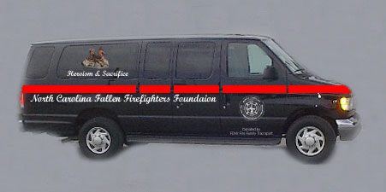
Family Transport Van
The NCFFF, in cooperation with Hendrick Motors, will provide a passenger family transport van to support families of fallen firefighters.

Slide 35
NCFFF Contact Info
  N.C. Fallen Firefighter Foundation
  2501 Blue Ridge Road
  Suite 150
  Raleigh, NC 27607
919-697-5350
www.ncfff.org

Slide 36
Dignity Memorial Information
The Dignity Memorial Public Servants Program offers dignified and honorable tributes at no cost for career and volunteer firefighters, law enforcement officers, and emergency services personnel who fall in the line of duty. The Dignity Memorial Bereavement Program includes various discounts and other benefits.
For more information call 919-828-4311 or go to www.ncpublicservants.com.

Slide 37
Wilbert Vault Information
The Wilbert Burial Vault offers a vault at no charge to the family, for career and volunteer firefighters who fall in the line of duty.

Slide 38
Information Needed:
Statements from:
  The chief
  All involved personnel
  Any witnesses

Slide 39
Information Needed
Copies of the following documents
(for the deceased):
  Driver’s license
  Social security card
  Beneficiary card
  Training records

Slide 40
Information Needed:
Spouse’s information:
  Full name
  Address
  Social security number
Dependent(s) information:
  Full name(s)
  Date(s) of birth(s)
  Social security number(s)

Slide 41
Information Needed:
  Original Death Certificate
  Fire Incident Reports w/ original signature
  Casualty Reports w/ original signature
  Autopsy Reports w/ original signature

Slide 42
Information Needed:
  Press release and news articles
  Marriage license
  If previous marriage, copies of legal separation and divorce documents
  Birth certificate for the deceased, spouse and children

Slide 43
Information Needed:
  Senate Bill 37 and House Bill 19 during the 2015 legislative session extended tuition reimbursement to those dependents whose legal guardians were killed in the line of duty.
  Adoption papers for proof of legal guardianship.

Slide 44
Information Needed:
  Reports (all with original signature):
  Law Enforcement
  Toxicology
  Hospital
  Ambulance/1st Responder

Slide 45
Possible Benefits
State Line-of-Duty Death Benefit
  Senate Bill 99 2015 Changes
    Section 9 – Effective July 1, 2015, the payment of the death benefit to the beneficiary is a lump sum payment of $50,000.
North Carolina State Firefighters' Association Line of Duty Death $50,000.00 and AD & D $25,000
N.C. Society of Fire/Rescue Service Instructors $10,000.00

Slide 46
N. C. State Firefighters' Association
In addition, a seat belt benefit of $10,000 will be paid.
Full scholarships for college education provided for any dependent child. These scholarships essentially cover all expenses except spending money.

Slide 47
N. C. State Firefighters' Assoc. Fraternal Insurance
Available for members under 55 years of age at a cost of $40 per year, per member:
35 and under $ 40,000.00
36 – 40 $ 30,000.00
41 – 45 $ 20,000.00
46 – 50 $ 10,000.00
51 – 55 $ 3,000.00
56 – 60 $ 2,500.00
61 and over $ 2,000.00

Slide 48
Possible Benefits
Federal Public Safety Officers Death Benefits $343,589.00 (2017) + “COLA”
Workers Compensation $287,350 – $431,000

Slide 49
Worker’s Compensation
This benefit is calculated at a specific rate equaling 2/3 of his/her weekly wages for 500 weeks.
Presently the maximum rate is $862 for career emergency personnel and a minimum rate of $574.70 (2/3 of the maximum) for volunteer emergency personnel.

Slide 50
Worker’s Compensation
Benefits for minor age beneficiaries are also figured for 500 weeks or until age of 18, whichever is longer.
Part-time emergency personnel rate would be based on the salary paid for those part-time hours worked.

Slide 51
Possible Benefits
Local Relief Fund
Pension Fund Reimbursement (Monies paid into fund)
Any department benefits, such as VFIS, Brotherhood Term Life, etc.
If a member of NVFC:
  $10,000 AD&D (it is doubled to $20,000 if it is emergency response related).
Each year the chief should review all benefits the department has with its members.

Slide 52
State Death Benefit
This benefit pays a total of $50,000.00 in a lump sum payment.
No “remarriage” penalty.

Slide 53
State Death Benefit
As of July 1, 2003, when a firefighter dies as the direct and proximate result of a heart attack suffered while on duty, within 24 hours after participating in a training exercise, or responding to an emergency situation, the firefighter is presumed to have been killed in the line of duty.

Slide 54
N. C. Assoc. of Rescue and Emergency Medical Services
Will pay $100,000.00 for a line of duty death. Upon approval by the Industrial Commission, this benefit will make an initial payment of $20,000 and $20,000 annually until claim is paid in full.

Slide 55
N. C. Assoc. of Rescue and Emergency Medical Services
Dismemberment and/or Accidental Death (coverage is 24 hours a day) $20,000
Natural deaths pay $1,000

Slide 56
N. C. Assoc. of Rescue and Emergency Medical Services
BENEVOLENT BROTHERHOOD – Must be a member.
Death benefit is $5,500 which is payable upon death of a member in the fund. (Benefit increases $1,000 with each increase in membership of 1,000.)

Slide 57
N. C. Assoc. of Rescue and Emergency Medical Services
A spouse and/or dependent(s) of a line of duty death are eligible to receive scholarships and have choice of:
  Two year scholarship of $2,000
  Four year scholarship of $15,000

Slide 58
Pension Fund
2016 Legislative session changed the N.C. Fire and Rescue Squad Pension Fund disbursement in the event of a member death.
If a member is killed in the line of duty their beneficiary will receive their retirement benefit starting at age 55.

Slide 59
Public Safety Officer Benefit (PSOB)
This benefit is paid as follows:
  Surviving spouse with no dependents receives full payment.
  Surviving spouse with surviving dependents: The spouse receives half of full amount and the remaining half is divided equally among the dependents.
  If there is no surviving spouse or dependent, the payment will be made to the surviving parents of the deceased.
This benefit is not paid to the estate.

Slide 60
Public Safety Officer Benefit (PSOB)
The PSOB program also includes educational assistance through the Public Safety Officer's Educational Assistance (PSOEA).
Currently, the maximum award for a full-time student is $860 per month and proportionately less for part-time students.

Slide 61
Public Safety Officer Benefit (PSOB)
This educational assistance may be used to defray relevant expenses:
  Tuition & Fees
  Room & Board
  Books
  Supplies
  Other education-related costs

Slide 62
Federal Legislation
Hometown Heroes Survivors Benefits Act of 2003:
  Congressman Bob Etheridge introduced HR 5334 in 2002.
  President signed into law December 15, 2003.
This bill is to ensure that a public safety officer who suffers a fatal heart attack or stroke while on duty shall be presumed to have died in the line of duty.

Slide 63
United States Fire Administration
USFA Firefighter Fatalities: www.usfa.dhs.gov
  Notices of firefighter fatality
  Information about on-duty U.S. firefighter fatalities
  Database that allows visitors to search for firefighters honored at the National Fallen Firefighters Memorial

Slide 64
United States Fire Administration
  Description of the memorial
  Database that provides statistics related to the circumstances surrounding fatalities
  The annual USFA firefighter fatality report
  Information about Public Safety Officer Benefits (PSOB)

Slide 65
Questions?

Slide 66
North Carolina
Chief 101
Relief Fund

Slide 67
Program Objectives
Describe administration of Firefighters’ Relief Fund Program.
List requirements for participation.
Explain how money can be spent.
Provide contact information.

Slide 68
What is the Relief Fund?
Firefighters’ Relief Fund is found in N.C.G.S. 58-84-35
House Bill 1034-Ratified Session Law 2014-64 Page 3.
(a) The board of trustees shall have entire control of the funds derived from the provisions of this Article, and shall disburse the funds only for the following purposes:
(1) To safeguard any firefighter in active service from financial loss, occasioned by sickness contracted or injury received while in the performance of his duties as a firefighter.
(2) To provide a reasonable support for those actually dependent upon the services of any firefighter who may lose his life in the fire service of his town, city, or state, either by accident or from disease contracted or injury received by reason of such service. The amount is to be determined according to the earning capacity of the deceased.

Slide 69
What is the Relief Fund?
Firefighters’ Relief Fund uses (cont.)
(2a) To provide assistance, upon approval by the Executive Director of the State Firefighters' Association, to a destitute member firefighter who has served honorably for at least five years. The determination of destitute shall be based on the inability of the firefighters, through no fault of their own, to provide basic provisions to themselves or their families. Such basic provisions include, but are not limited to, assistance with housing, vehicle or commuting expenses, food, clothing, utilities, medical care, and funeral expenses.
(3) Repealed by Session Laws 1985, c. 666, s. 61.
(4) To provide for the payment of any firefighter's assessment in the Firefighters Fraternal Insurance Fund of the State of North Carolina if the board of trustees finds as a fact that said firefighter is unable to pay the said assessment by reason of disability.

Slide 70
What is the Relief Fund?
Firefighters’ Relief Fund uses (cont.)
(5) To provide for benefits of (i) supplemental retirement, including payment of firefighters' monthly assessments for the North Carolina Firefighters' and Rescue Squad Workers' Pension Fund, (ii) workers compensation, including the payment of premiums to the Workers' Compensation Fund established under G.S. 58-87-10, and (iii) other insurance and pension protection for firefighters otherwise qualifying for benefits from the Firefighters' Relief Fund as set forth in Article 85 of this Chapter.
(6) To provide for educational benefits to firefighters and their dependents who otherwise qualify for benefits from the Firefighters' Relief Fund as set forth in Article 85 of this Chapter.
(7) To provide for annual physicals that are required for firefighter positions by the Department of Labor or are recommended by the National Fire Protection Association.

Slide 71
Gross Premium Tax (GPT)
All N.C. licensed insurance companies pay to the N.C. Department of Revenue a portion of the Fire & Lightning coverage of all property insurance Gross Premium Tax (GPT).
Simple Definition = .074 Cents Per $100 of any N.C. insurance policy containing fire coverage (i.e. homeowners, rental, etc.)

Slide 72
Gross Premium Tax (GPT)
Distribution amounts:
Relief Fund (20%)
Volunteer Safety Workers Comp
Fund (20%)
Volunteer Fire Department Grants (20%)
General Fund Redistributed to F&R
Pension (40%)

Slide 73
GPT Example
2013 Funding
$30,364,035.00 Total Collected
$ 6,072,807.00 VSWCF (20%)
$ 6,072,807.00 Grants (20%)
$ 6,072,807.00 Relief Funds (20%)
$12,145,614.00 State General Fund
(Directed to Pension Fund with additional
funding from the state if needed.)
$180,000.00 NC State Firefighters’ Association (3%)
$155,000.00 OSFM Grants Administration (2%)
$120,000.00 OSFM Relief Fund (2%)

Slide 74
How is it funded?
  All county tax administrators report to the N.C. Department of Insurance the county population and the property tax value for each rated fire insurance district.
  Checks are then electronically sent to all departments with the provided Relief Fund account numbers.

Slide 75
Changes in Reporting
The “Report of Fire Conditions” has been renamed to “Firefighters Relief Fund Board of Trustees Report” or Board of Trustees Report for short (BTR).
This was done because the old “Report of Fire Conditions” was an outdated title that was used for collecting data that is no longer required.

Slide 76
N.C. Identity Management (NCID)
OSFM now requires all users of our new database to establish a North Carolina Identity Management Account (NCID). This account must be established in the fire chief’s name and be an individual account.
Only the fire chief may access this new database. You may not use the fire chief’s NCID account to access this database.
If the chief wishes to allow another authorized member to have access to this database, they have an option to assign an administrative assistant.

Slide 77
Finance Officer Delegation
  The City/County Finance Officer has the option to delegate the responsibility for the BTR to the local fire chief. (N.C.G.S. 58-84-46)
  Several counties and cities have exercised this option. This means the responsibility to file the Board of Trustees Report now belongs to the local fire chief.

Slide 78
Rules for Participation
  Must elect relief fund board of trustees:
    Two are elected by the fire department.
    Two are appointed by the City or County Commissioners.
    One is appointed by the Insurance Commissioner.
    One of the five members will be elected as the relief fund treasurer. (All local relief fund treasurers are covered by a bond for losses in excess of $25,000 and up to a max of $1,000,000 which is paid from the administrative fees.)
    2016 legislative change: once appointed, the elected member serves until replaced.

Slide 79
Rules for Participation
  Department must be a member of the N.C. State Firefighters’ Association.
    For information, contact the Executive Director at 1-800-253-4377.
  Financial report of local relief fund:
    Submitted to N.C. State Firefighters’ Association.
    Form is available to the department from NCSFA in June.
    Must be received annually by NCSFA by October 31.

Slide 80
Rules for Participation
  Firefighters’ Relief Fund Board of Trustees Report:
    Filed with the N.C. Firefighters’ Association effective July 1, 2017.
    Filed annually in January.
    NCSFA reports the BTR to NCDOI.
    Required by N.C.G.S. 58-84-46 for all rated fire districts.
    Provides the local relief fund board of trustees names and identifies the treasurer.

Slide 81
How Funds can be Spent
Two Classes of Relief Fund Uses:
Uses controlled by the LRFB.
The following uses are allowable if the LRFB has reviewed and approved them:
To assist financially any firefighter in active service for a sickness or injury contracted in the line of duty. The amount is dependent on need and availability of funds as determined by the LRFB upon review and the annual earning capability of the individual.

Slide 82
How Funds can be Spent
Two Classes of Relief Fund Uses:
Uses controlled by the LRFB
To provide reasonable support to family or dependents of a firefighter who may lose their life in the line of duty by accident or sickness. The amount is dependent on need and availability of funds as determined by the LRFB upon review and the annual earning capability of the individual.
To pay premiums in the Fraternal Insurance Fund of N.C., if the firefighter is a member and the LRFB has determined the firefighter cannot pay for reasons of disability.

Slide 83
How Funds can be Spent
Two Classes of Relief Fund Uses:
Uses controlled by the LRFB, but require approval from the NCSFA.
The reason for the review and approval of the NCSFA Executive Director is to ensure it is an allowable use, the fund is “financially sound” or stable, and the use will not reduce the funds to an extent where they would not be available for uses.

Slide 84
How Funds can be Spent
Two Classes of Relief Fund Uses:
Uses controlled by the LRFB, but require approval from the NCSFA.
If a firefighter becomes financially destitute, the LRFB can request the use of funds to be used to assist the firefighter.

Slide 85
How Funds can be Spent
Two Classes of Relief Fund Uses:
Uses controlled by the LRFB, but require approval from the NCSFA.
Upon approval of the LRFB and a request made and approval given by the Executive Director of the N.C. State Firefighters’ Association, the payment of monthly assessments in the N.C. Firefighters’ and Rescue Squad Workers’ Pension Fund is allowed.

Slide 86
Relief Fund Changes 2014
  Additional uses of Local Relief Funds:
  Fire and Rescue Squad Workers’ Pension Premium.
  Workers’ Compensation Premiums.
  Annual physicals required or recommended by N.C. Dept. of Labor or NFPA.
  Relief Fund administrative fees for checks and other banking fees.

Slide 87
Relief Fund Changes 2014
  Modernization of language and definitions (i.e. firemen – firefighter).
  Local and State Board to manage funds prudently according to Chapter 36E
  (GS 36E).
  Increased reporting requirements.
  Electronic transfer of checks from NCDOI.

Slide 88
Relief Fund Changes 2014
  New definition of destitute added:
The determination of destitute shall be based on the inability of the firefighters, through no fault of their own, to provide basic provisions to themselves or their families. Such basic provisions include, but are not limited to assistance with housing, vehicle or commuting expenses, food, clothing, utilities, medical care and funeral expenses.

Slide 89
Relief Fund Changes 2015
  New definition of firefighter added:
  Firefighter – Any person who meets all of the following requirements:
  Is a volunteer, employee, contractor or member of a rated and certified fire department.
  Performs work or training connected with fire protection, fire prevention, fire control, fire education, fire inspection, fire investigation, rescue, emergency medical services, special operations or performs the statutory duties and responsibilities of the fire chief as set forth in N.C.G.S. 160A-292.

Slide 90
Relief Fund Changes 2015
  (continued)
  Performs work or training at the direction of the fire chief.
  Is included on the certified roster submitted to the N.C. State Firefighters’ Association pursuant to N.C.G.S. 58-86-25.

Slide 91
Relief Fund Changes 2014
  Financially Unsound defined*:
  *“A local fund could not sustain a requested expenditure or could not make similar payments for five years without the local fund's balance falling below the greater of the following:
  1) Five hundred dollars ($500) multiplied by the number of eligible firefighters in the local department.
  2) Twenty thousand dollars ($20,000).”

Slide 92
Relief Fund Changes 2014
Increased Reporting Requirements starting in 2015:
  Details on the disbursements from local relief funds, including how much was disbursed for each allowable purpose and how many members received disbursements for those purposes.

Slide 93
Relief Fund Changes 2014
No legislative restriction on amount of spending.
“A local board of trustees shall not be restricted to making disbursements solely from the interest.”

Slide 94
Relief Fund Changes 2014
Local Bills vs. Public Bills
What is a local bill? Local bills are bills that are passed to address a specific issue or issues in a local area. These bills are introduced by local legislators on behalf of their constituents and only impact the areas designated within the bill.
What is a public bill? Public bills are those bills that are introduced and passed by the General Assembly and impact the state as a whole.

Slide 95
Relief Fund Changes 2014
Repeal of Local Law Provisions
  The following provisions contained within any local act enacted or amended prior to January 1, 2014, are hereby repealed:
  1) Any redirection, at the time of receipt, of funds directed to a fire district under N.C.G.S. 58-84-25(c) to a fund other than a local relief fund.
  2) Any restriction that would be inconsistent with N.C.G.S. 58-84-35(d).
  3) Any transfer of interest earned on a local relief fund from the local relief fund to another fund.

Slide 96
Relief Fund Changes 2014
Repeal of Local Law Provisions
  4) Any transfer of funds from a local relief fund to a supplemental retirement fund based on the local relief fund exceeding a certain amount.
  5) Any allowable expenditures that are not within the scope of the list provided in N.C.G.S. 58-84-35(a).
  6) Any variation from the certification requirement under N.C.G.S. 58-84-35(b).

Slide 97
Relief Fund Changes 2014
Repeal of Local Law Provisions
Regardless of the type of account in which they are held, relief funds cannot be hidden and must be reported on the annual financial report, and all funds must be administered by the Local Relief Fund Board.

Slide 98
Relief Fund Changes 2014
  New Maximum Balance (For July 1, 2015)
The balance of a local fire department's Firefighters’ Relief Fund for a given year shall not exceed the product of multiplying the number of members on the department's roster as of January 1 for that year by the sum of two thousand five hundred dollars ($2,500).
A local fire department whose relief fund balance at the time of annual financial report exceeds the maximum amount above shall not be entitled to receive a check for that year, and the Insurance Commissioner shall redistribute the funds that the department would have received to other eligible departments, first within the county, then statewide.

Slide 99
Relief Fund Changes 2014
  New Maximum Balance Exception:
  Supplemental Retirement Account (SRA)
  A board of trustees of a local Firefighters' Relief Fund may, with the authorization of and under guidelines provided by the North Carolina State Firefighters’ Association, dedicate a portion of the local Firefighters' Relief Fund towards providing supplemental retirement. If this SRA approved by NCSFA is used solely for supplemental retirement within the guidelines provided by the North Carolina State Firefighters’ Association, then such dedicated amounts shall not count towards the maximum allowable balance under subsection (a) of this section.

Slide 100
Relief Fund Changes 2014
  All N.C. firefighters are now protected by NCSFA LODD benefit regardless of membership in the association.
  The NCSFA AD&D coverage is not included in this statutory requirement.
Notes:
Note- In terms of federal civilian firefighters (Fort Bragg, Cherry Point, Camp Lejeune, Sunny Point, etc.) there are no clear cases to determine if this benefit will pay. It will ultimately be up to the Industrial Commission and any potential case law that may come from such a situation.

Slide 101
Frequently Asked Questions
  Who has control of the relief fund money?
    The Local Relief Fund Board of Trustees
  My department is owned and operated by municipal government. Do they control the relief fund?
    No. The Local Relief Fund Board of Trustees controls the funds.
  Can equipment or other purchases be made with relief fund money?
    No. N.C.G.S. 58-84-35 defines how the fund can be used.

Slide 102
Frequently Asked Questions
  Can the Local Relief Fund Board make all disbursement decisions?
    No.
    Disbursements for destitute firefighters, supplemental retirement, pension & other insurance protection, and educational benefits MUST be approved by the local board and the NCSFA.
    This is to ensure the fund balance will remain actuarially sound for its original intent, to assist an injured firefighter.

Slide 103
Frequently Asked Questions
  Who is responsible to file the membership, financial statement, and the Board of Trustees report?
    The fire department files the annual NCSFA membership and the Relief Fund financial statement with the N.C. State Firefighters’ Association annually by October 31.
    The City and/or County Finance Officer files the Board of Trustees report with the N.C. Department of Insurance annually by October 31, unless the Finance Officer delegates this responsibility to the local fire chief.

Slide 104
Frequently Asked Questions
Who appoints the Relief Fund Board of Trustees?
  The fire department elects two representatives, the City and/or County appoints two representatives, and the N.C. Insurance Commissioner selects one representative. One of the five board members will be elected to serve as the Relief Fund treasurer.

Slide 105
Frequently Asked Questions
Do the Relief Fund Board Members have to be residents of the fire district?
  The two fire department appointees shall be residents of the fire district OR active or retired members of the fire department.
  The two City/County Commissioner appointees shall be residents of the fire district.
  The N.C. Insurance Commissioner appointee shall be a resident of the fire district OR an active or retired member of the fire department.

Slide 106
Frequently Asked Questions
What is the term for Board Members?
The fire department and City/County Commissioners shall hold an election each January to elect their representatives to the board.
One member will serve for two years and one member will serve for one year.
Thereafter, each year in January they shall elect only one member, and his or her term of office shall be for two years.
The N.C. Commissioner of Insurance appointee shall serve at the pleasure of the Insurance Commissioner.

Slide 107
North Carolina
Chief 101
Firefighter’s and Rescue Squad Workers’ Pension Fund

Slide 108
Fire and Rescue Pension Revisions of 2013
Updated language in Article 86 of N.C.G.S. Chapter 58 to make the provisions gender neutral; for example, it replaces "firemen" with "firefighters." Also makes provisions regarding firefighters gender neutral in N.C.G.S. 25-9-406(i), 25-9-408(f), 147-69.2, 147-69.7(a) and 147-69.8.

Slide 109
Fire and Rescue Pension Revisions of 2013
Enacts new N.C.G.S. 58-86-2 to add a definitions section to Article 86 for words and phrases as used in this article.
  Eligible fire department
  Eligible firefighter
  Fully credited service
  Inactive member
  Training sessions

Slide 110
Definitions – Eligible Fire Department
"Eligible fire department" means a bona fide fire department which is certified to the N.C. Commissioner of Insurance by the governing body thereof, and determined as classified as not less than class "9S," and said fire department holds training sessions not less than four hours monthly.

Slide 111
Definitions – Eligible Firefighter
"Eligible firefighter" means all persons 18 years of age or older who are firefighters of the state of North Carolina or any political subdivision thereof, including those performing such functions in the protection of life and property through firefighting within a county or city governmental unit.
"Eligible firefighter" shall also mean an employee of a county whose sole duty is to act as fire marshal, deputy fire marshal, assistant fire marshal, or firefighter of the county.

Slide 112
Definitions – Fully Credited Service
"Fully credited service" means a period of time for which the Board has received certification that a member has met all eligibility requirements for participation in the pension fund and for which the Board has received timely, monthly payments under N.C.G.S. 58-86-35 or 58-86-40. In lieu of monthly payments under N.C.G.S. 58-86-35 or 58-86-40, a member may purchase fully credited service for any period of service as set forth in N.C.G.S. 58-86-45.

Slide 113
Definitions – Inactive Member
"Inactive member" means a member of the fund who is not on a leave of absence under N.C.G.S. 58-86-95 and who is not making timely monthly payments under N.C.G.S. 58-86-35 or 58-86-40.

Slide 114
Definitions – Training Sessions
"Training sessions" for eligible firefighters means sessions in which attendance will result in the preparation of, or knowledge gained by, the member in the area of fire prevention, fire suppression, or protection of life and property.
Such drill or training sessions held by the eligible fire department to meet the requirements of this article shall be held for the purpose of providing a learning or preparation experience for the members.

Slide 115
Fire and Rescue Pension Revisions of 2013
Deleted N.C.G.S. 58-86-5 to eliminate the six-member board of trustees of the North Carolina Firefighters’ and Rescue Squad Workers. Enacts N.C.G. S. 58-86-6 to create the Firefighters' and Rescue Squad Workers' Pension Fund Advisory Panel (the advisory panel).

Slide 116
North Carolina
Chief 101
Fire and Rescue Grant Programs

Slide 117
Program Objectives
Explain Volunteer Fire Department Fund and Rescue Fund Programs.
List requirements for participation.
Describe process and timeline for application.
Answer frequently asked questions.
Provide contact information.

Slide 118
What are the Grants?
Volunteer Fire Department Fund is a dollar-for-dollar matching grant used to:
  Assist fire departments in the most need.
  Purchase equipment.
  Make capital improvements.
  Help departments improve insurance class.
Rescue Grant Fund is a dollar-for-dollar matching grant used to:
  Assist fire departments and rescue squads in the most need.
  Purchase equipment.
  Make capital improvements.
  Help departments and squads improve rescue and EMS services.

Slide 119
How is it Funded?
Fire Grant
  All N.C. licensed insurance companies pay to the N.C. Department of Revenue a portion of the Fire & Lightning coverage of all property insurance at a rate of .074 basis points.
Rescue Grant
  The Volunteer Rescue/EMS fund is funded by 18 cents of each vehicle inspection sticker.

Slide 120
Gross Premium Tax (GPT)
All N.C. licensed insurance companies pay to the N.C. Dept. of Revenue a portion of the Fire & Lightning coverage of all property insurance Gross Premium Tax (GPT).
Simple Definition = .074 cents per $100 of any N.C. insurance policy containing Fire Coverage (i.e. homeowners, rental, etc.).

Slide 121
Gross Premium Tax (GPT)
Distribution Amounts
$ 30,364,035.00 Total collected from GPT FY 13/14.
$ 6,072,807.00 VSWCF (20%)
$ 6,072,807.00 Grants (20%)
$ 6,072,807.00 Relief Funds (20%)
$ 12,145,614.00 State General Fund
(Directed to Pension Fund with additional
funding from the state, if needed.)

Slide 122
GPT Example (2013 Funding)
$ 31,000,000.00 Total GPT Funding 2013
$ 6,000,000.00 Relief Fund 20%
$ 7,750,000.00 Grants 25%
$ 10,850,000.00 Pension 35%
$ 6,200,000.00 Workers Compensation 20%
$ 180,000.00 N.C. State Firefighters’ Assoc. 3%
$ 155,000.00 N.C. OSFM Grants 2%
$ 120,000.00 N.C. OSFM Relief Fund 2%
$ 4,395.00 State General Fund

Slide 123
Inspection Sticker Revenue
In 2013, the 18 cents on inspection stickers generated approximately $1.6 million.

Slide 124
Volunteer Fire Department and Rescue Grant Fund Changes
For fire departments that receive less than $50,000 from the City or County each year in support, the matching grant changes from 50/50 to 25/75, or $3 for every $1 matching.
Property acquired from the Department of Defense through the Firefighter Property (FFP) and Federal Excess Property Programs (FEPP) is now eligible for grants.

Slide 125
Volunteer Fire Department and Rescue Grant Fund Changes
  Grants are subject to the following priority order: (i) rescue units, (ii) rescue/EMS units, (iii) EMS units that are licensed as EMS providers under G.S 131E-155.1, and, finally, (iv) EMS units that are volunteer fire departments that are a part of a county's EMS system plan.
  For the grant, "EMS unit" means either (i) an EMS provider licensed under G.S 131E-155.1 or (ii) a volunteer fire or fire/rescue department that is part of its county's EMS system plan. The unit or squad must comply with existing State statutes and with eligibility criteria established by the North Carolina Association of Rescue and Emergency Medical Services, Inc.

Slide 126
Both Volunteer Grant Fund Changes
  Reimbursement of Funds
  If equipment purchased with grant funds is disposed of within five years of the date of the grant award funding its purchase, then the grant recipient shall reimburse the appropriate fund the amount of matching funds used for the purchase of the equipment, less depreciation.

Slide 127
Both Volunteer Grant Fund Changes
  Transfer of Purchased Equipment.
  – If a grant recipient shall cease to exist within five years of the date of award of the grant, it shall transfer, subject to the approval of the N.C. Department of Insurance, any and all equipment purchased with such grant funds to whichever department shall assume responsibility for providing service to the grant recipient's area of service or to another appropriate department that may effectively use the equipment.

Slide 128
How much funding can Fire and Rescue Grants provide?
Fire Grants
  N.C. Department of Insurance will match dollar-for-dollar up to $30,000 for the purchase of equipment and to make capital improvements.
Rescue Grants
  N.C. Department of Insurance will match dollar-for-dollar up to $25,000 for the purchase of equipment and to make capital improvements.

Slide 129
Is my organization eligible?
Fire departments must:
  Be rated or actively working with the NCDOI Fire Ratings & Inspections section.
  Serve a population of 12,000 or less.
  Be primarily volunteer with no more than 6 paid positions.
Rescue/EMS organizations must:
  Meet the criteria of N.C. Association of Rescue & EMS.
  Be primarily volunteer with no more than 10 paid positions.

Slide 130
Application Process
Applications are submitted via web interface.
From ncdoi.com select “Office of State Fire Marshal”
Then select: “Fire and Rescue Grants and Relief Fund”
You can also use: http://www.ncdoi.com/OSFM/Fire_Rescue_Grants_and_Relief_Funds
Fire chiefs are provided login credentials.

Slide 131
Fire and Rescue Grant Application Timeline
Volunteer Fire Department Fund
January: Fire chiefs are notified that the application is available.
March 1: Deadline to submit application.
May 15: Grant recipients announced.
September 30: Invoices and forms must be submitted to N.C. Department of Insurance to receive payment.

Slide 132
Fire and Rescue Grant Application Timeline
Volunteer Rescue, EMS Fund
Aug. 1: Fire/Rescue/EMS chiefs are notified that the application is available.
Oct. 1: Deadline to submit application.
Dec. 15: Grant recipients announced.
April 30: Invoices and forms must be submitted to N.C. Department of Insurance to receive payment.

Slide 133
Recipient Selection
Fire Grants
  Applications scored by point system.
  Funding from N.C. Department of Revenue entered into database.
  Computer selects applications with the lowest score (greatest need) until the available funding is exhausted.
Rescue Grants
  Applications scored by point system.
  Funding from DMV entered into database.
  Computer selects applications with the lowest score (greatest need) until the available funding is exhausted.

Slide 134
Frequently Asked Questions
  My fire department is owned and operated by a municipality. Can we apply?
    Yes. The department must serve a population of 12,000 or less.
    My department provides fire protection and rescue services. Do we provide only information regarding the fire service?
    No. Information for the entire entity must be provided.

Slide 135
Frequently Asked Questions
  Does the fire department have to request the full $30,000.00?
    No. We will match dollar-for-dollar up to the $30,000.00 maximum.

Slide 136
Frequently Asked Questions
  What type of equipment can we apply for?
    Protective equipment (on the body).
    Equipment to help department lower insurance rating.
    Miscellaneous fire-related equipment .
    Vehicles.
    Buildings.
    Computers.

Slide 137
Frequently Asked Questions
  What items are not typically approved through the Fire Grant?
    Training aids.
    Physicals.
    Physical fitness equipment.
    Furniture.
    Rescue equipment.
    Uniforms.
  If in doubt, call NCDOI.

Slide 138
Frequently Asked Questions
  Can the fire department purchase used/refurbished/reconditioned equipment?
    No. Equipment purchases must be new.
      Exception: Used vehicles with one year service/maintenance records.

Slide 139
Frequently Asked Questions
      Can the fire department order the equipment prior to the May 15 announcement date?
    No. Equipment ordered prior to May15 will not be honored.

Slide 140
Frequently Asked Questions
Are extensions allowed?
    No. The Fire Grant application must be submitted no later than March 1.
    The invoice/agreement forms must be submitted no later than September 30.
    Exceptions on invoices:
      30 day extension for delivery of turnout gear.
      5 month extension for vehicles or buildings.

Slide 141
Frequently Asked Questions
  Is backordered equipment allowed?
    No. Backordered equipment received/invoiced after September 30 will not be paid.
  Does the rescue/EMS provider have to wait until September 30 to submit the invoices?
    No. Upon delivery of all of the approved equipment, you may submit the invoices.
    Check requests are made to the controller’s office each Friday.

Slide 142
Frequently Asked Questions
  Do I have to be at the light rescue level to be eligible for the grant?
    No. The administrative code does not specify being at the light level, only that you meet the criteria set forth by the Association of Rescue and EMS.

Slide 143
Contact Information
N.C. Department of Insurance
Relief Fund Administrator
1-800-634-7854

Slide 144
Resources and Associations

Slide 145
Office of State Fire Marshal State Emergency Response Team
In the event of a large scale emergency in North Carolina, the N.C. Fire Service Emergency Response Plan is available to provide for the systematic mobilization, deployment, organization and management of fire-based resources.

Slide 146
Office of State Fire Marshal
State Emergency Response Team (SERT)
The initial/primary source for determination of available resources will be the State Emergency Response Team (SERT) inventory database.
  There are two methods to enter resources into the SERT inventory database.
    The first method is through periodic department NCRRS rating surveys conducted by NCDOI / OSFM.
    The second method is for the individual fire department to update their information via the NCDOI / OSFM website.
    The chief of the department makes the final decision as to what resources are available for deployment to any request for the department.

Slide 147
Office of State Fire Marshal
State Emergency Response Team (SERT)
What you will need to enter data:
  A copy of the NIMS Typing Guide For Apparatus.
  Equipment specifications: make, model, pump size, tank size, etc.
  Other helpful information: NCAFC Emergency Response Plan.
  NCAFC Field Guide for the Emergency Response Plan.

Slide 148
Office of State Fire Marshal
State Emergency Response Team (SERT)
Changes are to be made by the fire department chief.
You will need to have your department’s username and password. This information is emailed/mailed to the fire chief and should be retained by the fire chief and not shared with other members.
It is important that if there are any changes in the chief, the new address, email, or phone number be sent to us as soon as possible.
Should you have any questions regarding the SERT equipment updates, please contact Shirley Lofton via email: shirley.lofton@ncdoi.gov..

Slide 149
Office of State Fire Marshal Training Request System
In order to facilitate Fire/Rescue training requests, OSFM has developed an easy-to-use request system.
To enter a training request simply go to: http://www.ncdoi.com/osfm/Fire_Rescue_Training/Default.aspx?field1=Fire_and_Rescue_Training_Request

Slide 150
Office of State Fire Marshal Training Request System
Classes that can be requested include:
  Direct Delivery
    All National Fire Academy courses.
    Specialized training developed by OSFM, such as Rapid Intervention and Hydraulic Fracturing Response.

Slide 151
Office of State Fire Marshal Training Request System
Classes that can be requested include:
  Qualification
    Field delivered qualifications, such as TR Confined Space, Trench, Water, Live Fire Burn, LP Gas and many others.

Slide 152
Office of State Fire Marshal Training Request System
Classes that can be requested include:
Ratings and Inspections
9S Inspections
NCRRS Rating Schedule
Water Haul Inspections

Slide 153
Office of State Fire Marshal Training Request System
Classes that can be requested include:
Train-the-Trainer
Rapid Intervention
National Fire Academy courses

Slide 154
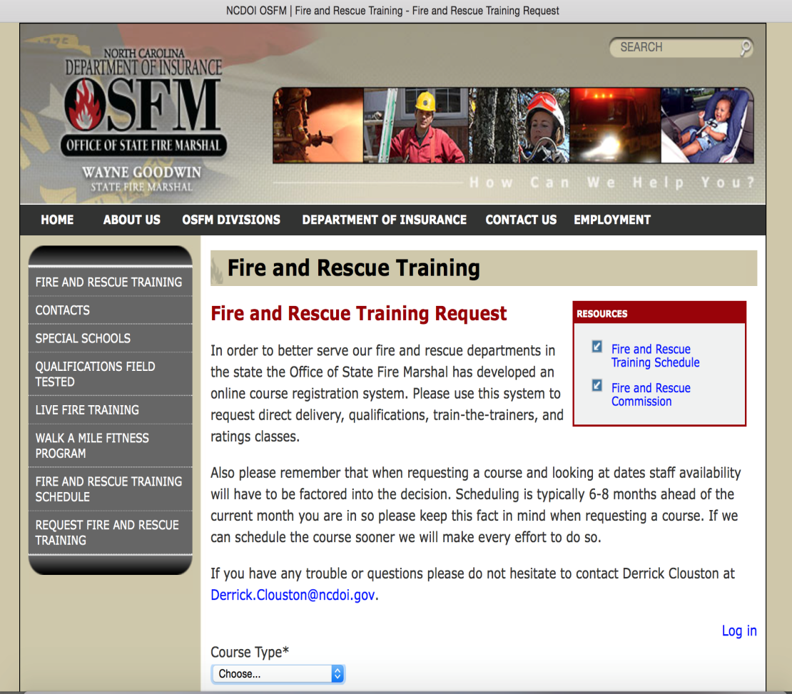
Office of State Fire Marshal Training Request System

Slide 155
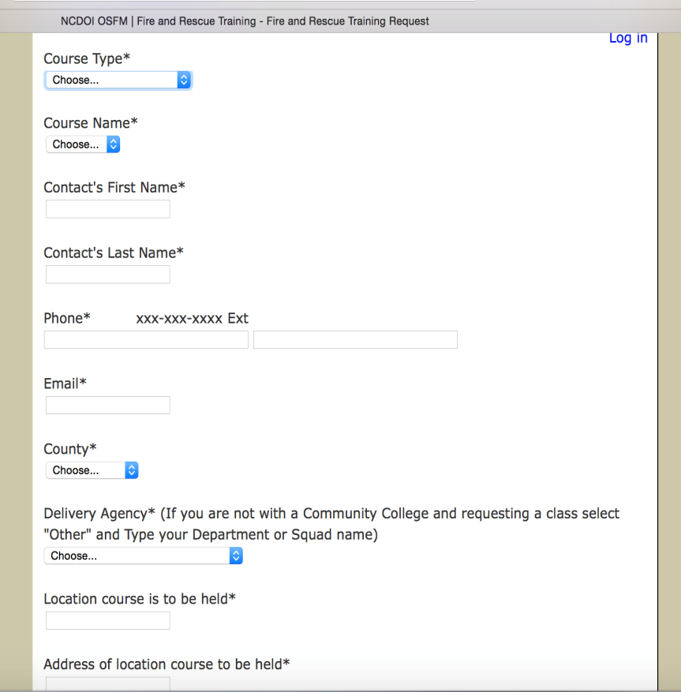
Office of State Fire Marshal Training Request System

Slide 156
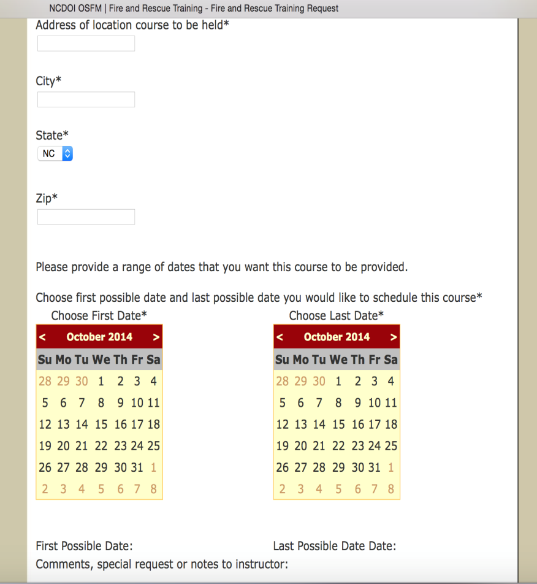
Office of State Fire Marshal Training Request System

Slide 157
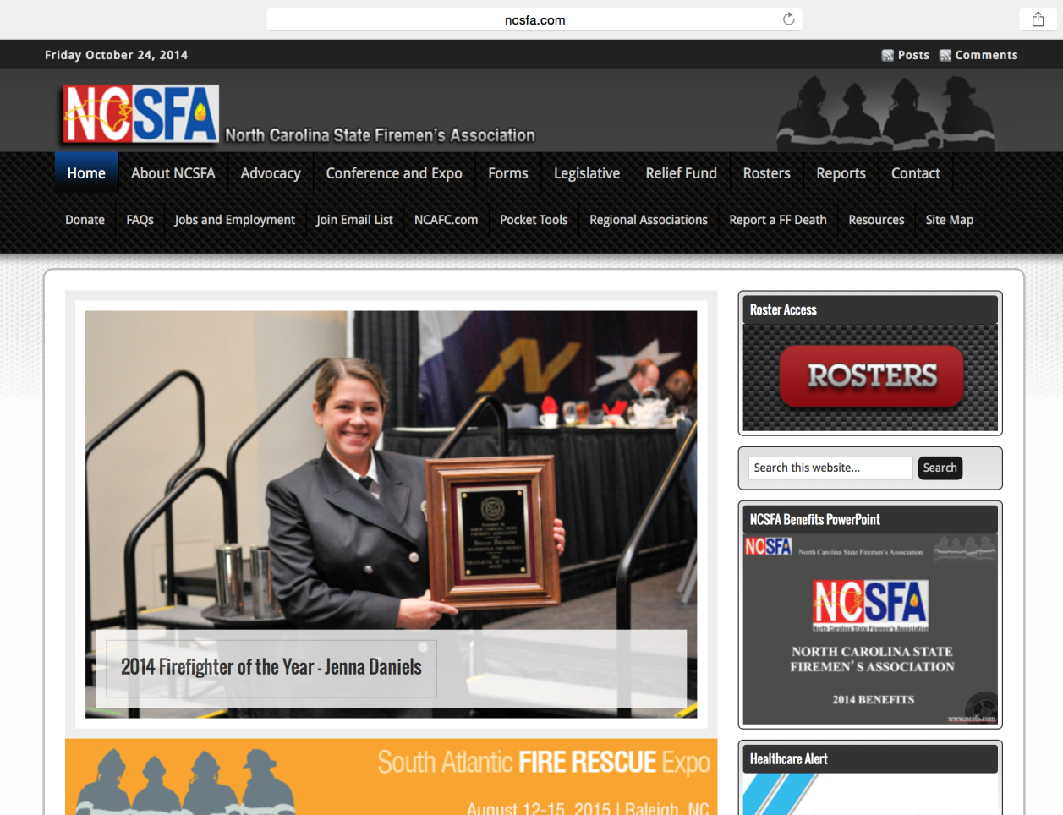
State Associations
N.C. State Firemen’s Association www.ncsfa.com

Slide 158
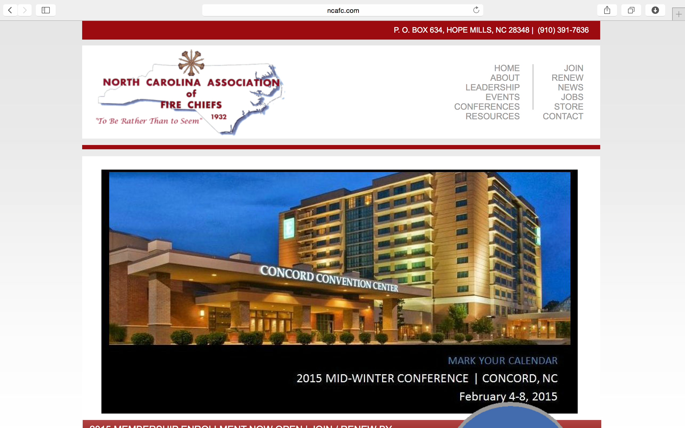
State Associations
N.C. Association of Fire Chiefs www.ncafc.com

Slide 159
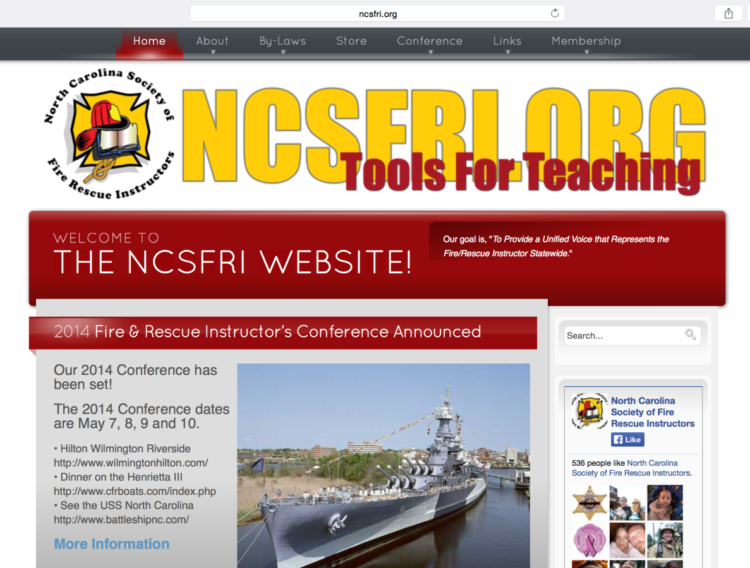
State Associations
N.C. Society of Fire/Rescue Instructors www.ncsfri.org

Slide 160
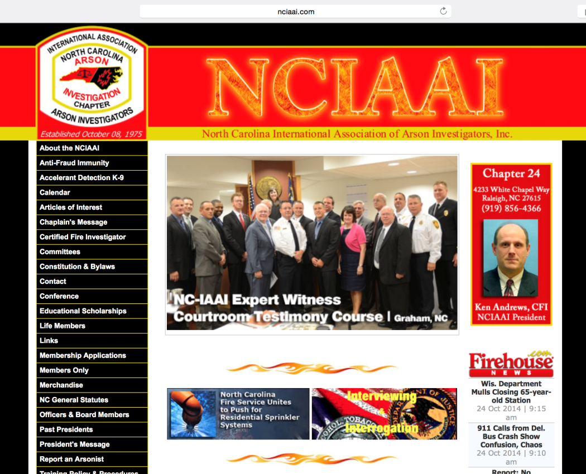
State Associations
N.C. Association of Arson Investigators www.nciaai.com/board

Slide 161
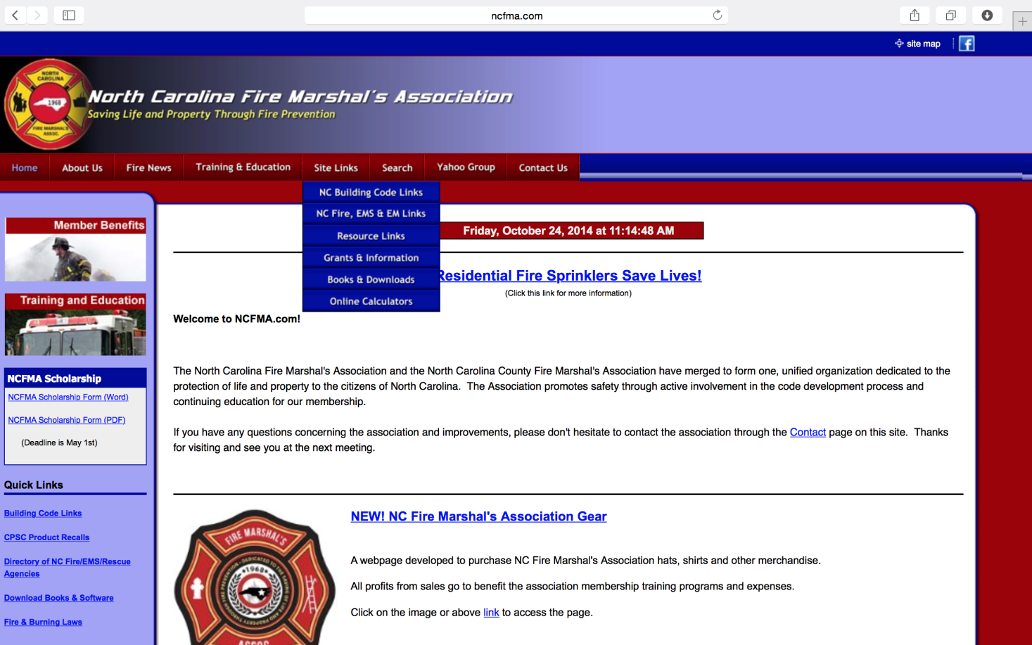
State Associations
N.C. Fire Marshal’s Association www.ncfma.com

Slide 162
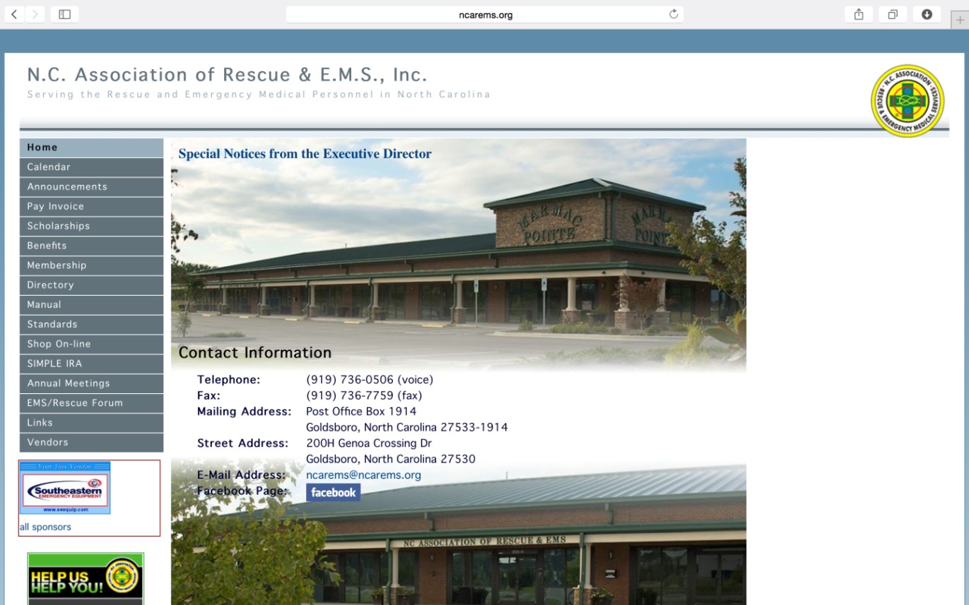
State Associations
N.C. Association of Rescue and EMS www.ncarems.org

Slide 163
Regional Associations
N.C. Eastern Carolina Firefighters Association
www.encfa.org
N.C. Piedmont Firefighters Association:
www.pncfa.org
Western N.C. Association of Firefighters:
www.wncaff.com

Slide 164
North Carolina
Chief 101-15
Concludes Here

Slide 165
North Carolina
Chief 101
Firefighter Safety, OSHA and NFPA

Slide 166
Program Objectives
  Identify the requirements set forth by OSHA that pertain to volunteer, career and combination fire departments.
  Identify the requirements set forth by NFPA that pertain to volunteer, career and combination fire departments.

Slide 167
OSHA Duty Clause
SEC. 5 (a) Each employer:
  shall furnish to each of his employees employment and a place of employment which are free from recognized hazards that are causing or are likely to cause, death or serious physical harm to his employee;
  2) shall comply with occupational safety and health standards promulgated under this Act.

Slide 168
OSHA Duty Clause
SEC. 5 (b) Each employee shall comply with occupational safety and health standards and all rules, regulations, and orders issued pursuant to this Act which are applicable to his own actions and conduct.

Slide 169
N.C. OSHA Program
The N.C. OSHA program is administered by the N.C. Department of Labor, not the N.C. Department of Insurance or the N.C. Office of State Fire Marshal.

Slide 170

OSHA Law
Contained in N.C. General Statutes G. S. 95-131.

Slide 171
N.C. G.S. 95-148
Safety and Health Programs of State Agencies and Local Governments
  The North Carolina Fire and Rescue Commission shall recommend regulations and standards for fire departments. (1973, c.295, s.23; 1983, c. 164; 1985, c, 544; 1989, c. 750, s. 3; 1991 (Reg. Sess., 1992), c. 1020, s. 1.)

Slide 172
Standards Enforcement
Purpose:
  “ … to insure so far as possible every working man and woman in the nation safe and healthful working conditions and to preserve our human resources…”

Slide 173
North Carolina is an
OSHA State

Slide 174
N.C. OSHA Regulations must meet or
exceed Federal OSHA Regulations.

Slide 175
National Fire Protection Association
What is NFPA?
  Non-Profit Corporation.
  Develops consensus standards through an intricate committee process.
  Standards are not laws, but can carry the weight of laws if adopted by enforcement agencies such as OSHA.
North Carolina is an
OSHA State

Slide 176
National Fire Protection Association
  Many federal agencies, such as DHS have adopted NFPA standards.
  www.nfpa.org
North Carolina is an
OSHA State

Slide 177
Parallel Standards
NFPA
Fire and Rescue
Specific
Standard
OSHA
General Industry
Standard

Slide 178
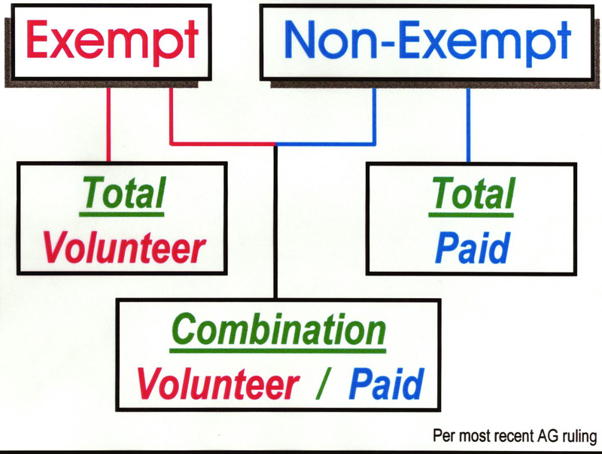
North Carolina is an
OSHA State

Slide 179
Standard of Care
  Defined as the level of competency anticipated or mandated during the performance of a service or duty.
North Carolina is an
OSHA State

Slide 180
Standard of Care
The last 50 years have taught us:
  Potential impacts are limitless.
  There are options in operational approaches.
  Initial responders need competency.
  Development of a Standard of Care has occurred.
North Carolina is an
OSHA State

Slide 181
Standard of Care
Influenced by:
  Laws
  Regulations
  Standards
  Guidance
  Knowledge
  Experience
North Carolina is an
OSHA State

Slide 182
Standard of Care –
Haz Mat
Standard of Care for Hazardous Materials
  Local government and first responder roles:
    Planning
    Preparedness
    Training
North Carolina is an
OSHA State

Slide 183
Liability
Liability – state of being liable.
Liable – owing a responsibility.
Liability – cannot be totally eliminated.
North Carolina is an
OSHA State

Slide 184
Negligence
Defined as “performance outside of the accepted Standard of Care.”
  If elements of the Standard of Care are not followed, it could be considered negligence.
  Negligence can be by the individual, an officer, the organization, or the employer.
North Carolina is an
OSHA State

Slide 185
Gross Negligence
Defined as “willful failure to meet the Standard of Care.”
  Can be applied to individuals or organizations.
  Remember that ignorance of the law (Standard of Care) is no excuse.
  Example: Personnel not required to wear appropriate PPE.
  Example: Failure to train.
North Carolina is an
OSHA State

Slide 186
Standard of Care & Liability
Remember that by operating within
the Standard of Care we, as
responders, will not need to worry
about legal implications.
North Carolina is an
OSHA State

Slide 187
North Carolina
Chief 101
Fire Department
Ratings and Inspections

Slide 188
Program Objectives
Understand the basis of the procedures that govern a ratings and response inspection.
Describe the various aspects of the response rating system as adopted in North Carolina.
Recognize various sources of information that will assist departments in preparing for an inspection.

Slide 189
Ratings and Certification
Consequences of noncompliance:
  Insurance Premiums
  Pension Funds
  Firefighter Relief Fund
  State and Federal Firefighters’ Death Benefits
  Grants

Slide 190
Status of N.C. Fire Districts
2009 2014
Fire Departments…………………… ..1280…….. 1249
Fire Districts………………………….. 1547…….. 1539
Municipal Districts……………… ….368……....373
Rural District…………………….. ..1179….….1166
Non-Profit Corporations……………… .911……. 1048
Municipal Departments……………….. 367…….... 373
County Departments………………...… ...2……........ 2

Slide 191
Status of N.C. Fire Districts

Slide 192
Fire Protection Definitions
Fire Insurance District
(G.S. 153A-233)
An area outside corporate limits with boundaries approved by the County Board of Commissioners for fire insurance purposes.

Slide 193
Fire Protection Definitions
Rural Fire Protection District
(G.S. 69-25)
An area outside corporate limits with boundaries designated by petition of 35% of the resident free-holders in which a fire tax not to exceed $0.15 per $100.00 valuation has been authorized by the resident qualified voters within the district.

Slide 194
Fire Protection Definitions
Fire Service District
(G.S. 153A-300)
  An area outside corporate limits with boundaries approved by the County Board of Commissioners in which a fire tax is levied without referendum for fire protection services. Such district or districts may include territory within corporate limits if approved by resolution of the municipal governing body.

Slide 195
Fire Insurance Districts
Fire Insurance Districts must be properly established and documented.
  For N.C. 9S Inspection purposes, only properly established Fire Insurance Districts can receive certification.
  Any Fire Insurance District not properly established must have corrections completed before inspection results can be issued.

Slide 196
Fire Department Ownership
Who actually “owns” the fire department?
  Is it part of a municipal government?
  Is it a non-profit organization?
  Who/What is the governing body of the fire department?

Slide 197
Fire Department Ownership
  Who pays the fire department bills?
  Who carries the worker’s compensation insurance on the fire department personnel?
  Who signs the annual certification roster for the department?
  Is there a contract to provide fire protection services?

Slide 198
Fire Department Ownership
  What is the organization’s legal name?
  If it is a non-profit, what is the name of the organization as it appears in its
  Charter/Articles of Incorporation?
  Is it the same name as on any contracts and legal documents of the organization?
  Who is the legal ‘head’ of the fire department?

Slide 199
Fire Department Ownership
  Does the organization’s legal name:
  match the name on the apparatus titles?
  match the name displayed on the apparatus and vehicles owned by the organization?

Slide 200
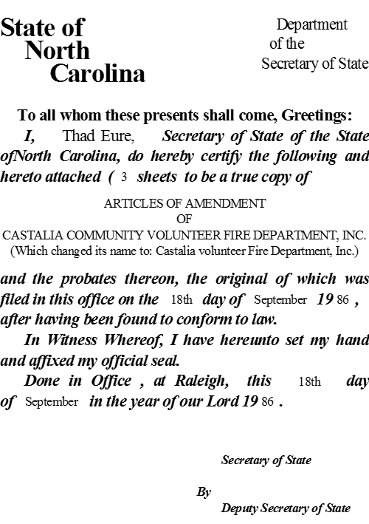

9S / 9E Rating Requirements
Sample of Fire Department
Charter in N.C.

Slide 201
9S / 9E Inspections - Charter
  Review your charter regularly with focus on:
    Article 1, which establishes the legal name of the organization.
    Article 3, which establishes the purpose for which the corporation is organized and what you are expected to provide and do.
    Maintaining the appropriate language used to describe the workings of the organization.

Slide 202
9S / 9E Inspections - Contract
  Contract with County and/or Municipality:
    Needed by a non-profit organization to provide service to a fire insurance district.
    Required signatures: One of the following combinations depending on organization.
        County Manager or the Chairman of the County Board of Commissioners plus Clerk to the Board.
        City or Town Manager / Administrator or Mayor plus the Town / City Clerk.
      President of the Board.
      Secretary of the Fire Department

Slide 203
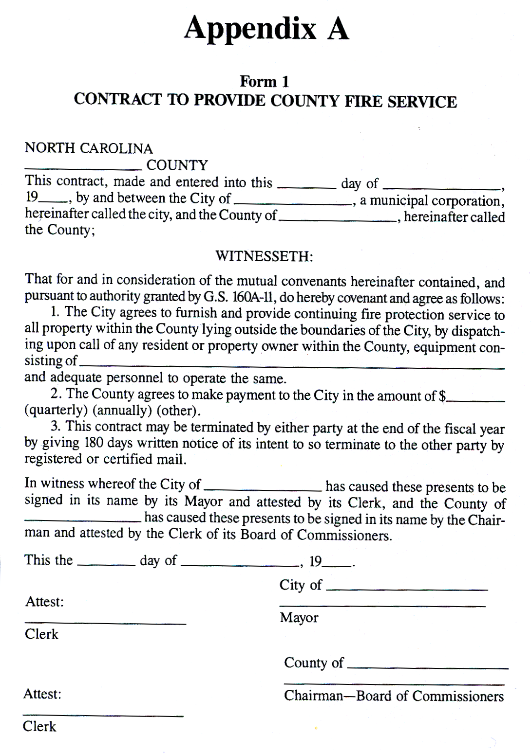
9S / 9E Inspections - Contract

Slide 204
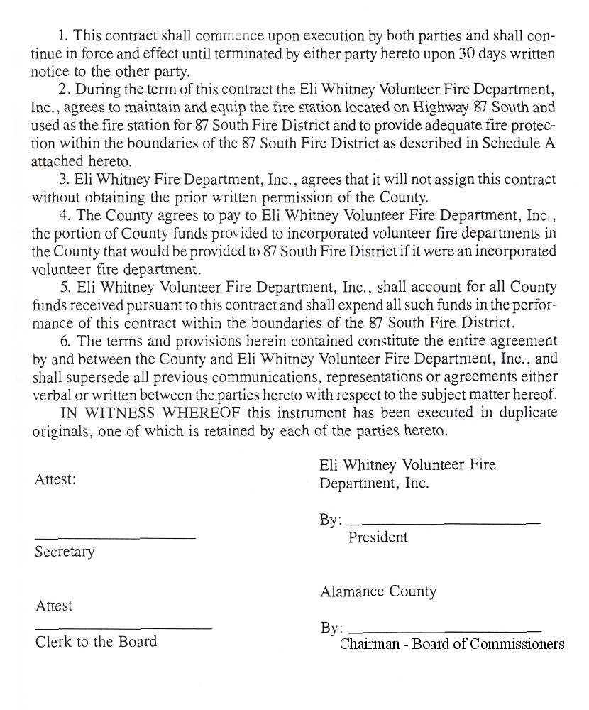
9S / 9E Inspections - Verification

Slide 205
9S / 9E Inspections - Verification
Verification by city/town:
  Needed by a municipal fire department stating that the department is in fact an entity of the municipality.
  See example on following slide for wording and signatures.

Slide 206
9S / 9E Inspections - Verification
WHEREAS, The Volunteer Fire Department of the Town of ______________ is a
part of the town’s municipal government and serves as an agency of the town; and
WHEREAS, The Volunteer Fire Department of the Town of ______________ has
requested confirmation of this Agency relationship; and
WHEREAS, This Agency’s relationship is longstanding and generally
acknowledged.
NOW THEREFORE, Be it resolved, that the Town of _______________ does hereby
confirm this Agency’s relationship and does verify by this Resolution that relationship.
Adopted this __________ day of ________________________, 19___.
ATTEST:
______________________________ ________________________________
Clerk Mayor

Slide 207
9S / 9E Inspections - Designation
Designation of Insurance District:
  Needed for rural fire insurance districts.
  See example on following slide for language.

Slide 208
9S / 9E Inspections - Designation
Taken from the minutes of the _______________ County Board of
Commissioners on ___________________, ____.
The _______________ presented a written description and map of the
________________ Fire District which are set out in full in the minutes. He
indicated that the Commissioners needed to approve the description and map
prior to certification and map had been approved by the NC Department of
Insurance. Commissioner _________________ made the motion to approve
the map and description of the ________________ Fire District which was
seconded by Commissioner ________________ and passed by unanimous
vote.
___________________________ _____________________________
County Clerk to the Board
(Affix County Seal Here)

Slide 209
9S / 9E Inspections - Map
GIS map or DOT map with written description.
  Written descriptions no longer needed if approved GIS mapping is provided.

Slide 210
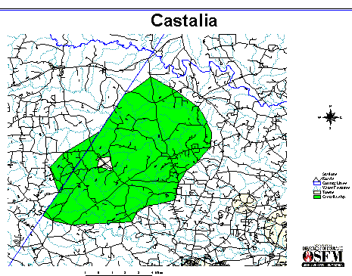
9S / 9E Inspections - Map
Example of GIS Map

Slide 211
9S / 9E Inspections - Personnel
Current NCSFA Certification Roster of members meeting these requirements:
  20 firefighters for main station:
    18 firefighters
    2 traffic control
  8 additional firefighters are required for each sub-station.
  See example of official NCSFA form.

Slide 212
9S / 9E Inspections - Personnel
Junior Members and / or those members less than 18 years of age:
  will NOT be credited as part of the 20 / 8 member roster.
  will NOT be credited towards minimum 12 / 4 member average response requirement.

Slide 213
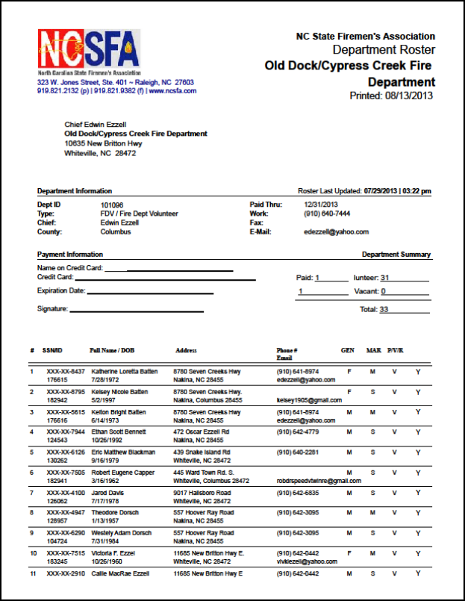
Sample of NCSFA Roster.

Slide 214
9S / 9E Inspections – Service Test
Service Test on Engine.
  Must be signed.
  See example on following slide.

Slide 216
9S / 9E Inspections – Weight Tickets
Certified weight tickets with following:
  Apparatus owner (fire dept. name)
  Apparatus number
  Date weight obtained
  Gross weight of apparatus
  Certification (of scales) stamp on ticket
  Signature of weighmaster (person conducting the weight measurement)

Slide 217
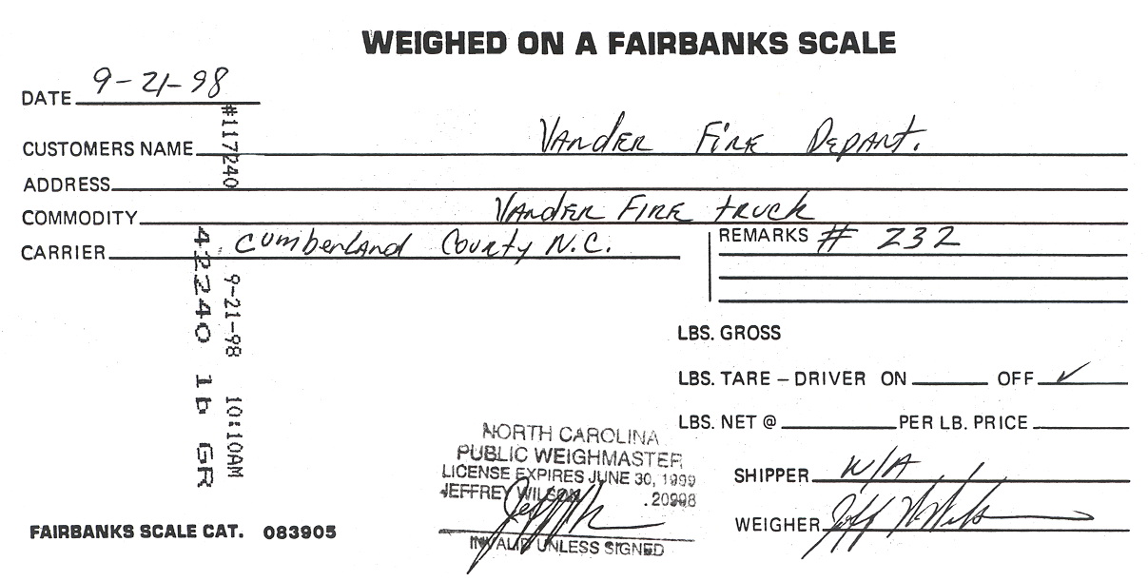
9S / 9E Inspections – Weight Tickets

Slide 218
9S / 9E Inspections – Clothing Form
Personnel Protective Clothing Form.
  See example on following slide.

Slide 220
9S / 9E Inspections – Alarm Logs
Review of alarm logs (call reports)
  Required to verify response to reported structural alarms.
  Your inspector will review for:
    date, time and location.
    response of 4 personnel and 1 engine on reported structure fires.
    plus any additional information pertinent to the alarm.

Slide 221
9S / 9E Inspections – Attendance Logs
Review of department membership attendance logs:
  for both drills and meetings.
  accurate records must be maintained to validate attendance of the department membership to drills and meetings.
  minimum of 36 hours attendance required by each member, per year.

Slide 222
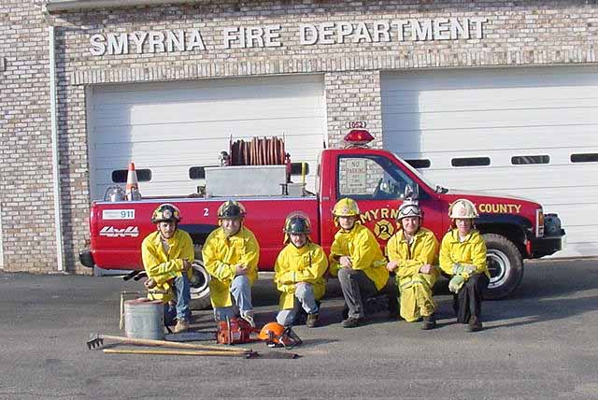
9S / 9E Inspections Drills / Meetings
  Departments are required to provide a minimum of 48 hours of drills and meetings per year.
  Firefighters are required to attend a minimum of 36 hours of training drills per year.

Slide 223
9S / 9E Inspections - Inventory
Apparatus Equipment Inventory
  Individual check-off sheets covering maintenance requirements will be reviewed.
  The inspector will look for:
    date of equipment inventory check.
    notes of condition of equipment.
    resolution of any problems / concerns.

Slide 224
9S / 9E Inspections - Maintenance
  Maintenance Check-off Sheet
    All required ‘first out’ apparatus must have Apparatus Equipment and Maintenance Check-off Sheets.
    Maintenance sheets must be checked monthly.

Slide 225
Equipment - Engine
Engine Minimum Requirements
  750 GPM UL Approved Fire Pump
  500 Gallon Water Tank
  GVW Plate
  Annual Vehicle Safety Inspection

Slide 226
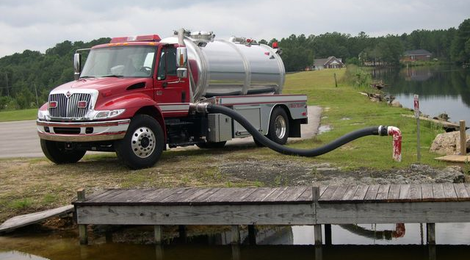
Equipment - Tanker
Minimum Tanker Requirements
  Minimum 1,000 Gallon Water Capacity
  Adequate Hose for Filling & Dumping
  Properly Baffled
  G.V.W. Plate
  Annual Vehicle Safety Inspection

Slide 227
Vehicle Safety Inspections
Your OSFM Inspector will expect you to provide the necessary documentation on your apparatus and vehicles to verify the N.C. or Federal Vehicle Safety Inspections have been completed and are current.

Slide 228
Vehicle Safety Inspections
Apparatus/Vehicle Weight Type of Inspection Required
10,000 lbs. or less N.C. Inspection
10,001 lbs. or more N.C. or Federal Inspection

Slide 229
Vehicle Safety Inspections
  Federal Safety Inspections of Apparatus
    Fire department must forward copies of the inspection paperwork to N.C. DMV for recording.
    Stephen Saucier
    Safety & Emissions Inspection
    1100 New Bern Ave. Room 104
    Raleigh, NC 27699
    ssaucier@ncdot.gov
    Phone: (919) 861-3037
    Failure to do so will result in financial penalties, per vehicle, levied against the non-compliant department.

Slide 230
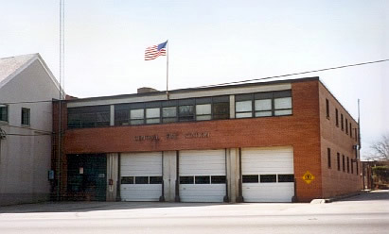
Fire Station Buildings
  All fire station buildings shall provide suitable heating, as well as all weather protection of the department’s response equipment.

Slide 231
N.C. OSFM Fire Ratings Inspectors
Davie Summey / Davie.Summey@ncdoi.gov
Tony Bailey / Tony.Bailey@ncdoi.gov
Chet Hill / Chet.Hill@ncdoi.gov
Vernon Ward / Vernon.Ward@ncdoi.gov
Deral Raynor / Deral.Raynor@ncdoi.gov
Terry Young / Terry.Young@ncdoi.gov
Jeremy Hunt / Jeremy.Hunt@ncdoi.gov
N.C. DOI / Office State Fire Marshal
1202 Mail Service Center
Raleigh, North Carolina 27699-1202
1-800-634-7854 / (919) 647-0000
fax: (919) 715-0063

