Slide 1
North Carolina Chief 101
Firefighter Safety, OSHA and NFPA

Slide 2
Chief 101 Class
This class will satisfy the 9S inspection criteria as specified by the North Carolina Administrative Code. The primary objective of the course is to inform current and future chief officers of the various aspects and complexities surrounding the operations and organization of North Carolina fire departments.

Slide 3
Program Objectives
Identify the requirements set forth by OSHA that pertain to volunteer, career and combination fire departments.
Identify the requirements set forth by NFPA that pertain to volunteer, career and combination fire departments.

Slide 4
OSHA Duty Clause
SEC. 5 (a) Each employer:
shall furnish to each of his employees employment and a place of employment which are free from recognized hazards that are causing or are likely to cause, death or serious physical harm to his employee;
2) shall comply with occupational safety and health standards promulgated under this act.

Slide 5
OSHA Duty Clause
SEC. 5 (b) Each employee shall comply with occupational safety and health standards and all rules, regulations, and orders issued pursuant to this Act which are applicable to his own actions and conduct.

Slide 6
N.C. OSHA Program
The N.C. OSHA program is administered by the N.C. Department of Labor, not the N.C. Department of Insurance or the N.C. Office of State Fire Marshal.

Slide 7
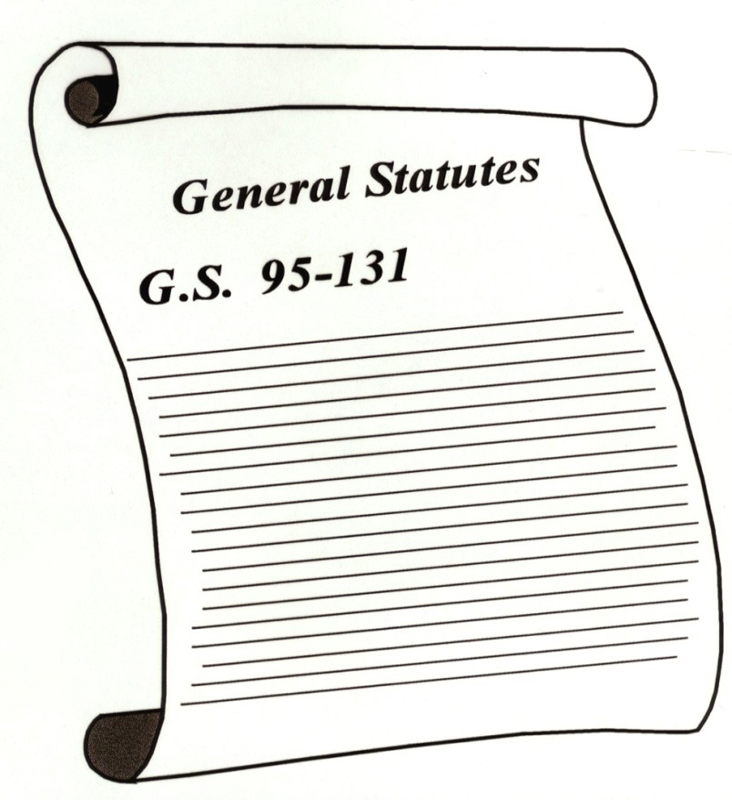
OSHA Law
Contained in N.C. General Statutes G. S. 95-131.

Slide 8
N.C. G.S. 95-148
Safety and Health Programs of State Agencies and Local Governments
The North Carolina Fire and Rescue Commission shall recommend regulations and standards for fire departments. (1973, c.295, s.23; 1983, c. 164; 1985, c, 544; 1989, c. 750, s. 3; 1991 (Reg. Sess., 1992), c. 1020, s. 1.)

Slide 9
Standards Enforcement
Purpose:
“ … to insure so far as possible every working man and woman in the Nation safe and healthful working conditions and to preserve our human resources…”

Slide 10
North Carolina is an
OSHA State

Slide 11
N.C. OSHA Regulations must meet or
exceed Federal OSHA Regulations.

Slide 12
National Fire Protection Association
What is NFPA?
Non-Profit Corporation.
Develops consensus standards through an intricate committee process.
Standards are not laws, but can carry the weight of laws if adopted by enforcement agencies such as OSHA.
North Carolina is an
OSHA State

Slide 13
National Fire Protection Association
Many federal agencies, such as DHS, have adopted NFPA standards.
www.nfpa.org
North Carolina is an
OSHA State

Slide 14
Parallel Standards
NFPA
Fire and Rescue
Specific
Standard
OSHA
General Industry
Standard

Slide 15
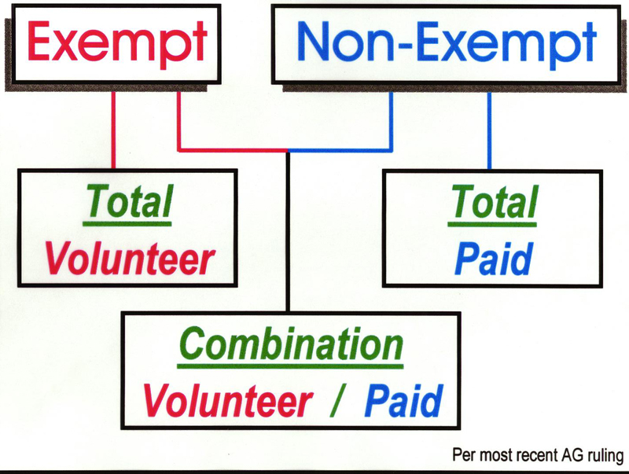
North Carolina is an
OSHA State

Slide 16
Standard of Care
Defined as the level of competency anticipated or mandated during the performance of a service or duty.
North Carolina is an
OSHA State

Slide 17
Standard of Care
The last 50 years have taught us:
Potential impacts are limitless.
There are options in operational approaches.
Initial responders need competency.
Development of a Standard of Care has occurred.
North Carolina is an
OSHA State

Slide 18
Standard of Care
Influenced by:
Laws
Regulations
Standards
Guidance
Knowledge
Experience
North Carolina is an
OSHA State

Slide 19
Standard of Care – Haz Mat
Standard of Care for Hazardous Materials
Local government and first responder roles
Planning
Preparedness
Training
North Carolina is an
OSHA State

Slide 20
Liability
Liability – state of being liable.
Liable – owing a responsibility.
Liability – cannot be totally eliminated.
North Carolina is an
OSHA State

Slide 21
Negligence
Defined as “performance outside of the accepted Standard of Care.”
If elements of the Standard of Care are not followed, it could be considered negligence.
Negligence can be by the individual, an officer, the organization or the employer.
North Carolina is an
OSHA State

Slide 22
Gross Negligence
Defined as “willful failure to meet the Standard of Care.”
Can be applied to individuals or organizations.
Remember that ignorance of the law (Standard of Care) is no excuse.
Example: Personnel not required to wear appropriate PPE.
Example: Failure to train.
North Carolina is an
OSHA State

Slide 23
Standard of Care & Liability
Remember that by operating within the Standard of Care we, as responders, will not need to worry about legal implications.
North Carolina is an
OSHA State

